Slide 1

Blinkit Sales Analysis
This report analyzes Blinkit's sales, customer satisfaction, and inventory distribution to identify key insights and opportunities for optimization.

Slide 2
Project Roadmap
1
Requirement Gathering
Define project scope and objectives.
2
Data Walkthrough
Understand data structure and content.
3
Data Connection
Establish connection to data sources.
4
Data Cleaning
Ensure data accuracy and consistency.
5
Data Modeling
Structure data for analysis.
6
Data Processing
Prepare data for analysis.
7
Dax Calculation
Create measures and calculations.
8
Dashboard Lay outing
Design dashboard layout and structure.
9
Chart Development and formating
Develop charts and visualize data.
10
Dashboard Development
Build the interactive dashboard.
11
Insight Generation
Analyze data and generate insights.

Slide 3

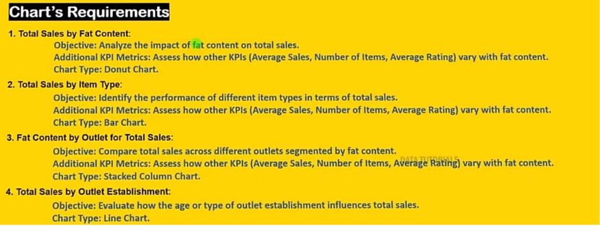
Busniess Requriement

Slide 4

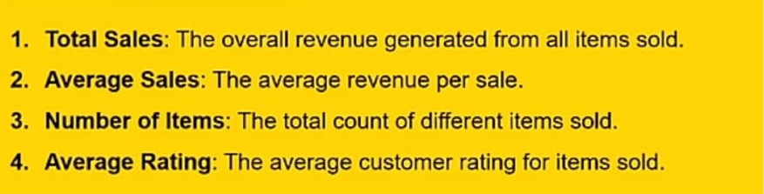
KPI'S Requirement

